Slide 1
Employee time tracking app
Server – created using Java Spring framework
Database – MySQL Workbench and ODBC connectors
User interface for employees – created using C# and Windows Forms
User interface for admin – created using javascript, html and css

Slide 2
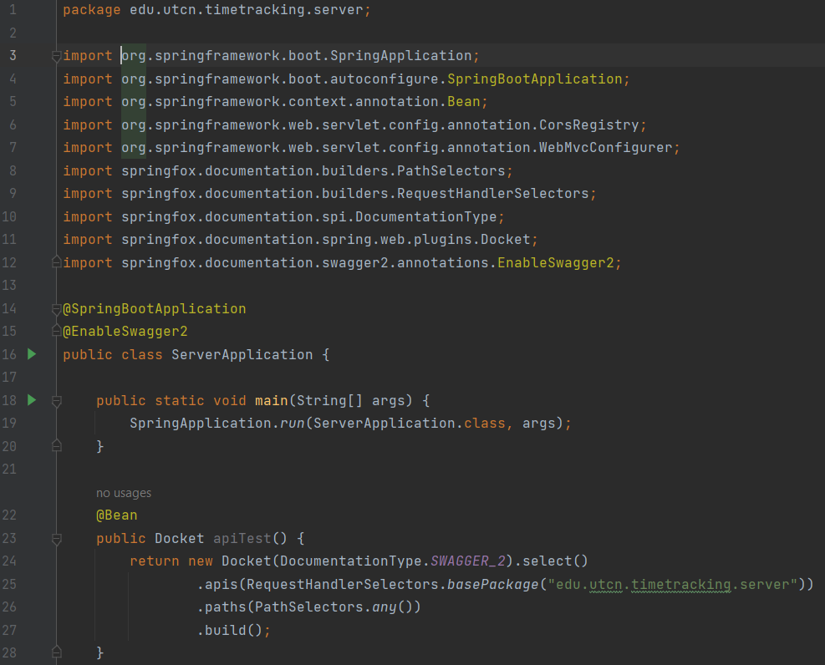
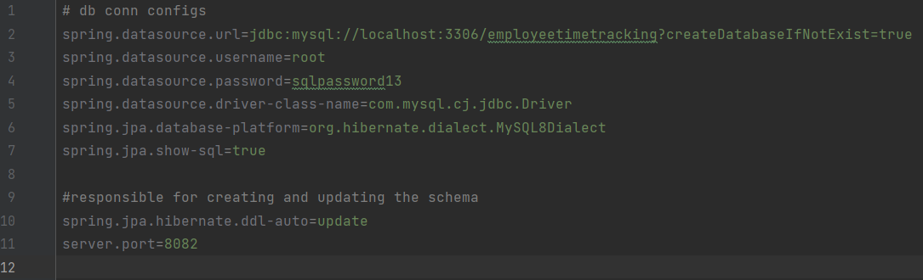
Server
Main app
Properties

Slide 3


Database
Employee
EmpCheck

Slide 4
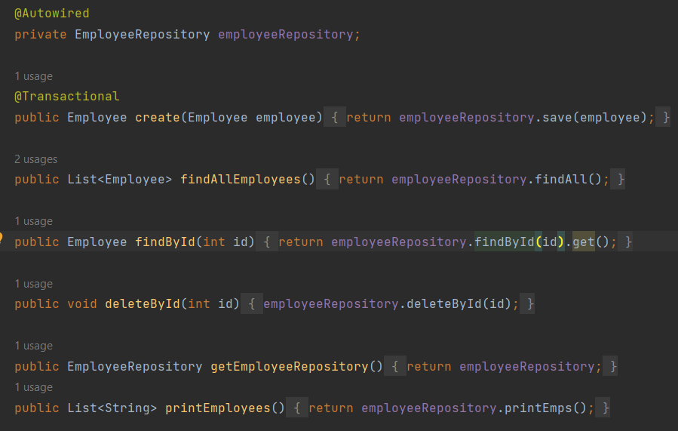
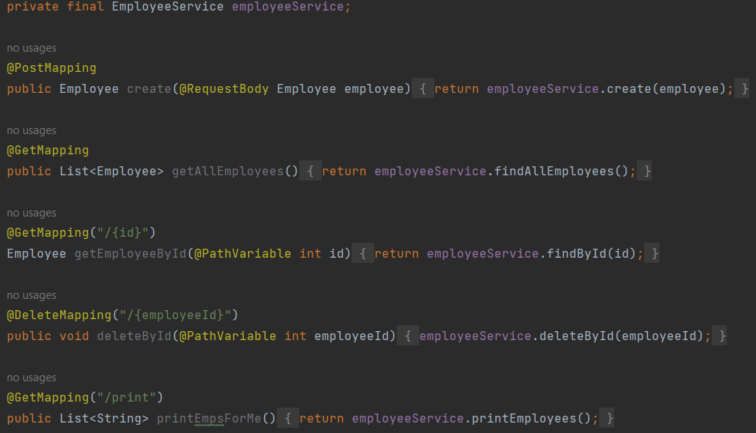
Employee class
Atributes
Service with functionalities
Endpoints
id
name
hourlyRate
empChecks
enrollDate

Slide 5
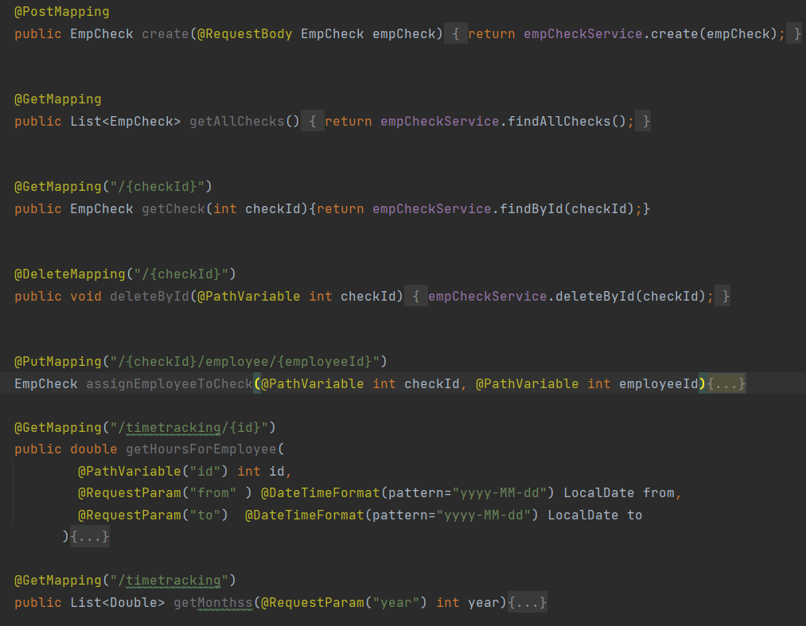
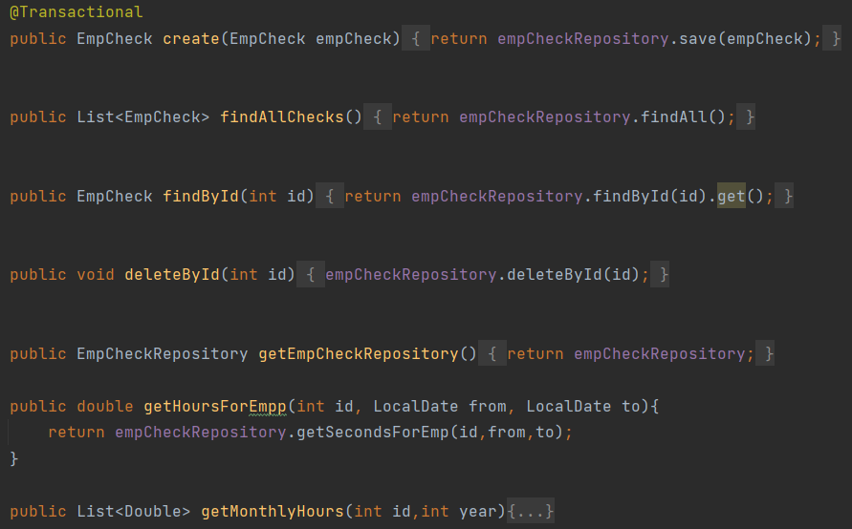
EmpCheck class
Atributes
Service with functionalities
Endpoints
id
employee
check_in
check_out
timeCheck

Slide 6
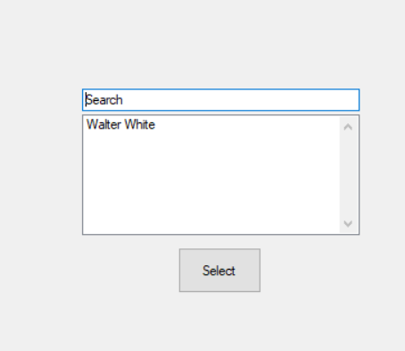
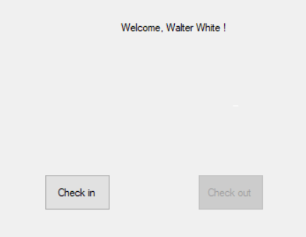
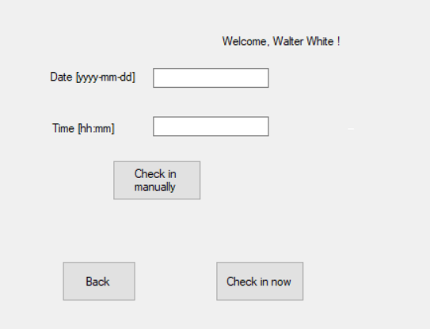
User interface

Slide 7
